Slide 1
PEGA Decisioning Essentials

Slide 2
Agenda – Session 3
Introduction to Creating Decisioning Application
Cassandra Database
Artifacts & NBAD Tests Rulesets
Access Groups
Overview of Application Definition

Slide 3
POC Application
a
s
A Banking Enterprise called XYZ Wishes to promote various services and products such as Debit Cards, Credit Cards, Loan Services to new customers as well as their existing customers to significantly increase the customer value and thus generate high business revenue.
Our goal is in short to provide the next best action!
Web Coding
Globalization
I
i
Big Basket
Trolly Boy
J
Price Tag

Slide 4
Application Creation
Creating decisioning application is similar to BPM Application creation.
Enable the PEGA Marketing framework.
Select PEGA Marketing (CDH) framework in new application wizard
Now click on Next button.
Wizard will take care of application creation

Slide 5
Car & Xcar Model

Slide 6
Car (Customer Analytics Record) Model
CAR model is customer analytics record. The data model and skeleton of maintained customer data.
This is provided by business for CDH implementation.
Can be stored into amazon S3 Repository or locally in CustomerData database

Slide 7
XCAR (extended customer analytics record)
XCAR is data model provisioned by PEGA Market place for industry specific implementation.
This contain all the required industry specific data model such as EMI, Loan , Credit card etc data model for a banking business that can be reused along with classes & tables mapped.
Download Sample XCAR
https://community.pega.com/marketplace/component/1to1-financial-services-data-model?

Slide 8
NBAD Template

Slide 9
NBAD Template
NBAD Template (Next Best Action Designer Template) is a pre-defined next best action designer configuration data which includes pre-loaded actions, treatments, categories, models for us to get started.
Download a sample NBAD Template below
https://community.pega.com/marketplace/component/nba-designer-template-retail-banking
Both XCAR and NBAD are available within wizard

Slide 10
Application Artifacts

Slide 11
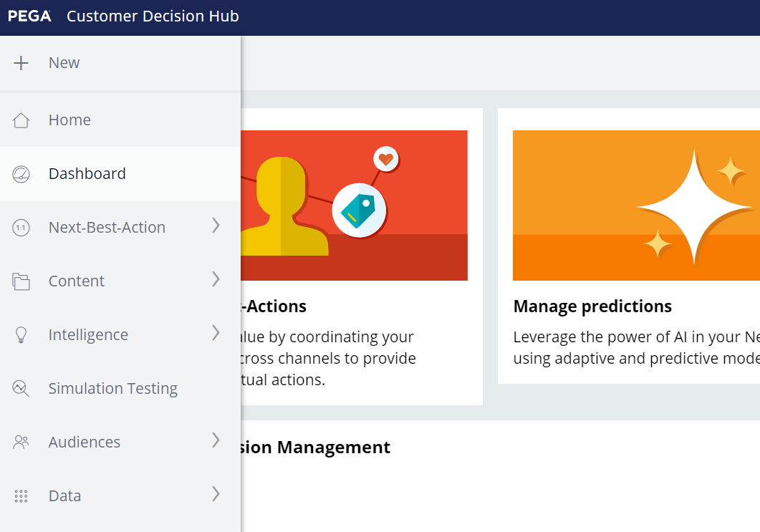
Auto-Generated Artifacts
Artifacts Ruleset
Cassandra Database
Decision Data Store (DDS)
Used to store all auto-generated rules created in customer decision hub.
Should be always highest version UNLOCKED to allow auto generated rules creation.
Used for Decisioning POC & Like production ruleset for CDH Implementation.
Created with <APPNAME:ARTIFACTS>
Used to store critical information such as customer data and associated data.
Can be associated locally as staging table to store mediatory information
Used to store the Cassandra data – Run the DDS Dataset
Provision to associate to external Cassandra database. But all CRUD operations can be done via DDS service with DDS Dataset

Slide 12
Advantages of Cassandra Database
PEGA has internal dedicated Cassandra database primarily used by decisioning implementations.
Advantages
Distributed & High Performance
High reliability & maintainability
Used for storing DDS information
Data Shared on multiple machines

Slide 13
Context Dictionary
Context dictionary is used to setup relationship between various entities and their associated information such as below
Primary context – Main targeted audience for decisioning such as customers, leads
Associated context – Associated information of primary context such as products/services/cards
Secondary context – Secondary targeted audience later switched as primary for marketing.
Wizard creates a product to deploy entire application as well as context dictionary.

Slide 14
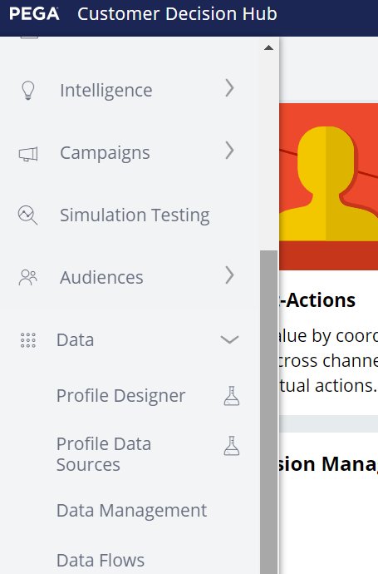
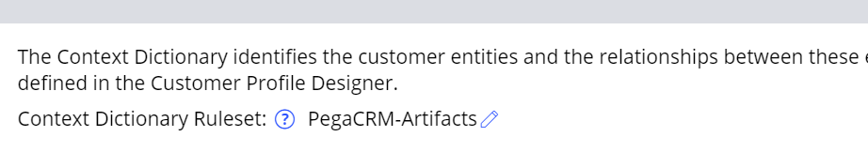
Customer Profile Designer
Starting from PEGA 8.7 Customer data is stored as profiles under customer profile designer and we can add additional profiles etc Starting from 8.6 version,
All the associated data related to the context is now stored under customer profile designer.
Inorder to access the customer profile designer,
Navigate to customer decision hub > Data > Profile Designer

Slide 15
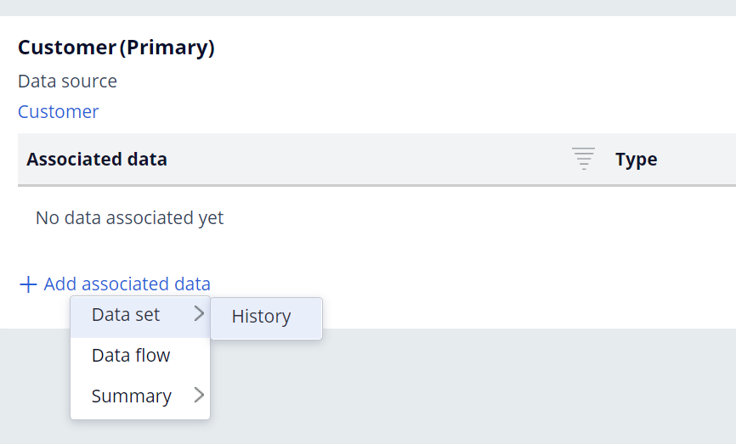
Customer Profile Designer
We can add associated data directly for PRIMARY CONTEXT within the customer profile designer.
Click on Edit & Add Associated Data
We need to create an dataset (usually a database table data set) inorder to connect the associated data with a primary context.
Only the data sets that have a common column between primary context and associated data will be displayed in the drop down.

Slide 16
NBAD Tests
NBADTests (Next Best Action Designer Tests) used to perform unit testing in lower environments using PERSONAs for strategy and other pega decisioning features.
- This is a unit testing ruleset to store test cases and test suites.
- Only for testing , not require to deploy to higher environments.
- Store strategy test cases and other unit test cases for decisioning.

Slide 17
Questions!

